Slide 1
Microprocessor BSc CSIT II SEM
Instruction Cycle
Chapter Three
Bijay Babu Regmi
bijay.regmi@deerwalk.edu.np

Slide 2
Instruction Cycle
A program residing in the memory unit of the computer consists of a sequence of instructions. The program is executed in the computer by going through a cycle for each instruction. Each instruction cycle in turn is subdivided into a sequence of sub cycles or phases. In the basic computer each instruction cycle consists of the following phases:
Fetch an instruction from memory
Decode the instruction
Read the effective address from memory if the instruction has an indirect address.
Execute the instruction

Slide 3
Continued….
Initially, the program counter PC is loaded with the address of the first instruction in the program.
The sequence counter SC is cleared to 0, providing a decoded timing signal T0. After each clock pulse, SC is incremented by one, so that the timing signals go through a sequence T0, T1, T2, and so on.
The micro operations for the fetch and decode phases can be specified by the following register transfer statements.
- T0: AR←PC
- T1: IR←M[AR], PC←PC + 1
- T2: D0,……, D7←Decode IR(12-14), AR←IR(0-11), I←IR(15)

Slide 4
Continued….
Since only AR is connected to the address inputs of memory, it is necessary to transfer the address from PC to AR during the clock transition associated with timing signal T0. The instruction read from memory is then placed in the instruction register IR with the clock transition associated with timing signal T1.
At the same time, PC is incremented by one to prepare it for the address of the next instruction in the program. At time T2, the operation code in IR is decoded, the indirect bit is transferred to flip-flop I, and the address part of the instruction is transferred to AR .

Slide 5
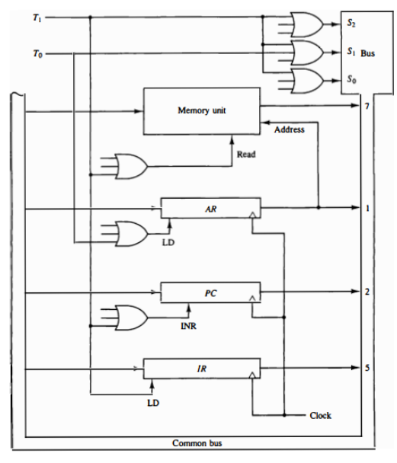
Figure: Register transfers for the fetch phase

Slide 6
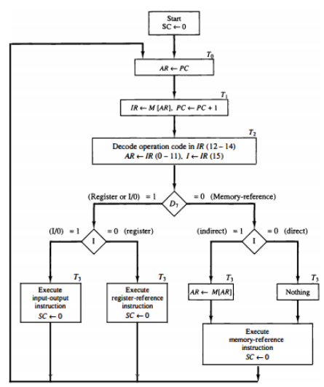
Figure: Flowchart for instruction cycle

Slide 7
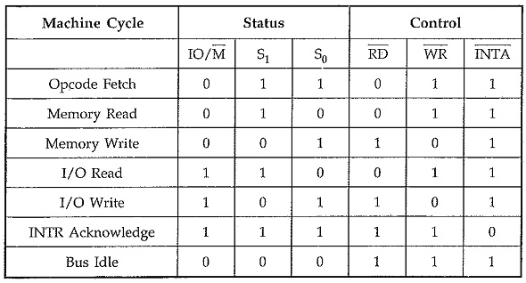
Machine Cycle in 8085
The time needed for completing one operation of accessing memory, I/O or acknowledging an external request is termed as Machine cycle. It is comprised of T-states. A machine consists of three to six T states. One subdivision of the operation completed in one clock period is termed as T-state. The following are the various machine cycles of 8085 microprocessor.
1. Opcode Fetch (OF)
2. Memory Read (MR)
3. Memory Write (MW)
4. I/O Read (IOR)
5. I/O Write (IOW)
6. Interrupt Acknowledge Cycle

Slide 8
Opcode Fetch Cycle
The first Machine Cycle of 8085 Microprocessor of every instruction is opcode fetch cycle in which the 8085 finds the nature of the instruction to be executed.
In this Machine Cycle in 8085, processor places the contents of the Program Counter on the address lines, and through the read process, reads the opcode of the instruction.
Fig. below shows the timing diagram for Opcode Fetch Machine Cycle 8085. The length of this cycle is not fixed. It varies from 4T states to 6T states as per the instruction.

Slide 9
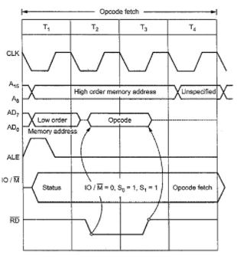
Continued….
Figure: Opcode Fetch machine cycle

Slide 10
Continued….
Step 1 : (State T₁): In T₁ state, the 8085 places the contents of program counter on the address bus. The high-order byte of the PC is placed on the A₈ – A₁₅ lines. The low-order byte of the PC is placed on the AD₀ – AD₇ lines which stays on only during T₁. Thus microprocessor activates ALE (Address Latch Enable) which is used to latch the low-order byte of the address in external latch before it disappears.
In T₁, 8085 also sends status signals IO/M, S₁, and S₀. IO/M specifies whether it is a memory or I/O operation, S₁ status specifies whether it is read/write operation; S₁ and S₀ together indicates read, write, opcode fetch, machine cycle operation, or whether it is in HALT state. In opcode fetch machine cycle status signals are : IO/M = 0, S₁ = 1, S₀ = 1.

Slide 11
Continued….
Step 2 : (State T₂) In T₂, low-order address disappears from the AD₀ – AD₇ lines. (However A₀ – A₇ remain available as they were latched during T₁). In T₂, 8085 sends RD signal low to enable the addressed memory location. The memory device then places the contents of addressed memory location on the data bus (AD₀ – AD₇).
Step 3 : (State T₃) During T₃, 8085 loads the data from the data bus in its Instruction Register and raises RD to high which disables the memory device.

Slide 12
Continued….
Step 4 : (State T₄) In T₄, microprocessor decodes the opcode, and on the basis of the instruction received, it decides whether to enter state T₅ or to enter state T₁ of the next Machine Cycle of 8085 Microprocessor. One byte instructions those operate on eight bit data (8 bit operand) are executed in T₄.
For example : MOV A, B, ANA D, ADD B, INR L, DCR C, RAL and many more.
Step 5 : (State T₅ and T₆) State T₅ and T₆, when entered, are used for internal microprocessor operations required by the instruction. During T₅ and T₆ , 8085 performs stack write, internal 16 bit; and conditional return operations depending upon the type of instruction.

Slide 13
Memory Read Cycle
The 8085 executes the memory read cycle to read the contents of R/W memory or ROM. The length of this machine cycle is 3-T states (T₁ – T₃). In this Machine Cycle in 8085, processor places the address on the address lines from the stack pointer, general purpose register pair or program counter, and through the read process, reads the data from the addressed memory location.
Memory read machine cycle is similar to the opcode fetch machine cycle. However, they use only states T₁ to T₃, and the status signal values (IO/M = 0, S₁ = 1, S₀ = 0) appropriate for memory read machine cycle are issued in T_{1.}

Slide 14
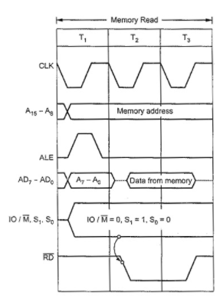
Continued….
Figure: Memory read machine cycle

Slide 15
Continued….
Step 1 : (State T₁) In T₁ state, microprocessor places the address on the address lines from stack pointer, general purpose register pair or program counter and activates ALE signal in order to latch low-order byte of address.
During T₁, 8085 sends status signals : IO/M = 0, S₁ = 1, and S₀ = 0 for memory read machine cycle.
Step 2 : (State T₂) In T₂, 8085 sends RD signal low to enable the addressed memory location. The memory device then places the contents of addressed memory location on the data bus (AD₀ -AD₇).
Step 3 : (State T₃) During T₃, 8085 loads the data from the data bus into specified register (F, A, B, C, D, E, H, and L) and raises RD to high which disables the memory device.

Slide 16
Memory Write Cycle
The 8085 executes the memory write cycle to store the data into data memory or stack memory. The length of this machine cycle is 3T states. (T₁ – T₃). In this Machine Cycle of 8085 Microprocessor, processor places the address on the address lines from the stack pointer or general purpose register pair and through the write process, stores the data into the addressed memory location.
The memory write timing diagram is similar to the memory read timing diagram, except that instead of RD, WR signal goes low during T₂ and T₃. The status signals for memory write cycle are : IO/M = 0, S₁ = 0, S₀ = 1. The following section describes the memory write machine cycle in step by step manner.

Slide 17
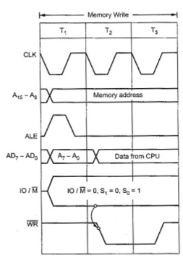
Continued….
Figure: Memory write machine cycle

Slide 18
Continued….
Step 1 : (State T₁) In T₁ state, the 8085 places the address on the address lines from stack pointer or general purpose register pair and activates ALE signal in order to latch low-order byte of address. During T₁, 8085 sends status signals :
IO/M = 0, S₁ = 0 and S₀ = 1 for memory write machine cycle.
Step 2 : (State T₂) In T₂, 8085 places data on the data bus and sends WR signal low for writing into the addressed memory location.
Step 3 : (State T₃) During T₃, WR signal goes high, which disables the memory device and terminates the write operation.

Slide 19
I/O Read and I/O Write cycles
The I/O read and I/O write machine cycles are similar to the memory read and memory write machine cycles, respectively, except that the 10/M signal is high for I/O read and I/O write machine cycles. High IO/M signal indicates that it is an I/O operation. Fig. below shows the timing diagrams for I/O read and I/O write cycles, respectively.

Slide 20
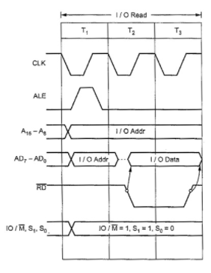
Continued….
Figure: I/O read memory cycle

Slide 21
Timing Diagram of MOV instruction:
The MOV instruction is used to copy the data of item, which is referred to as the second operand of the instruction (Constant value, register content, or memory content), into the location, which is referred to by its first operand (memory or register). In the MOV instruction, it is not possible to do direct memory to memory moves, but it is possible to do register to register moves.
Example:
2000H: MOV B, C
Opcode: MOV
Operand: B and C
Here B is used to indicate the destination register, and C is used to indicate the source register. In the above example, the content of C needs to be transferred into B.

Slide 22
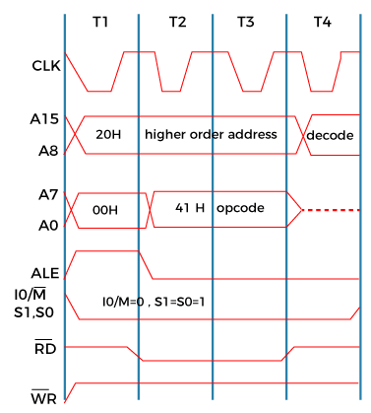
The above instruction needs the opcode fetching. So we can generate the timing diagram with the help of 4T states. For the opcode fetch, the IO/M (low active) = 0, S0 = 1, and S1 = 1.
Now the timing diagram of MOV instruction is described as follows:

Slide 23
In Opcode fetch (t1-t4 states):
00: It is used to indicate the lower bit of address in which opcode is stored.
20: It is used to indicate the higher bit of address in which opcode is stored.
ALE: It is used to send signals for data buses and multiplexed addresses. Only in t1, it will be used to fetch the lower bit of address with the help of address bus. In all the other cases, it will be used as a data bus.
RD (Low active): In t1 and t4, the signal is 1, which shows that none of the data is ready by a microprocessor. In t2 and t3, the signal is 0, which shows that the data is ready by a microprocessor.
WR (Low active): Here, the signal is 1 throughput which shows that none of the data is written with the help of a microprocessor.
IO/M (Low active): Here, the signal is 0 throughput which shows that the operation is performing on memory.
S0 and S1: If S0 and S1 try to fetch the opcode, then they will be 1.

Slide 24
Timing Diagram of MVI Instruction:
It stores the immediate 8 bit data to a register or memory location.
Example: MVI B, 43H
2000H: Opcode 2001H: 43H
The opcode fetch will be same in all the instructions.
Only the read instruction of the opcode needs to be added in the successive T states.
For the opcode fetch the IO/M (low active) = 0, S1 = 1 and S0 = 1. Also, 4 T states will be required to fetch the opcode from memory.
For the opcode read the IO/M (low active) = 0, S1 = 1 and S0 = 0. Also, only 3 T states will be required to read data from memory.

Slide 25
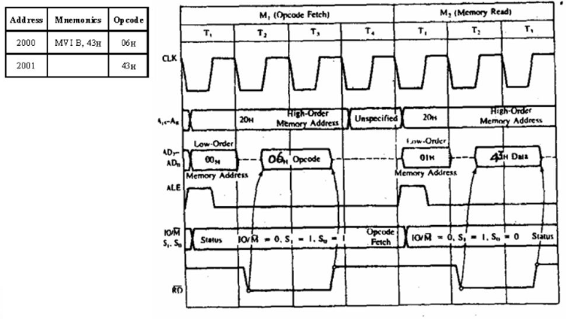

Slide 26
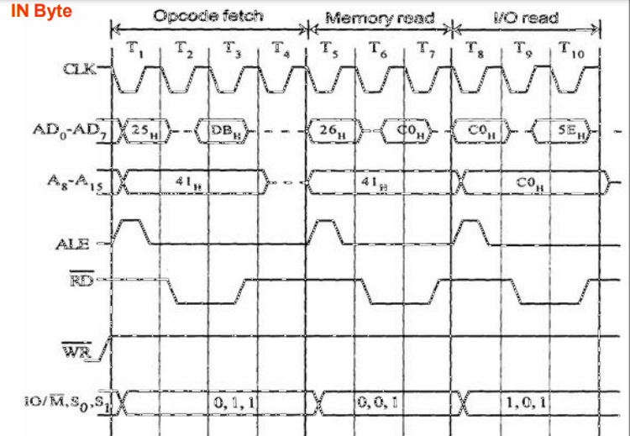
Timing Diagram of IN Instruction

Slide 27
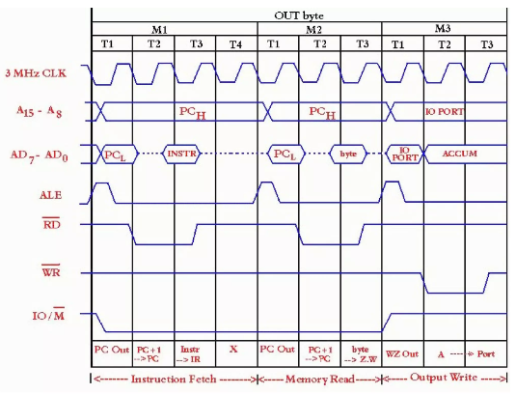
Timing Diagram of OUT Instruction

Slide 28
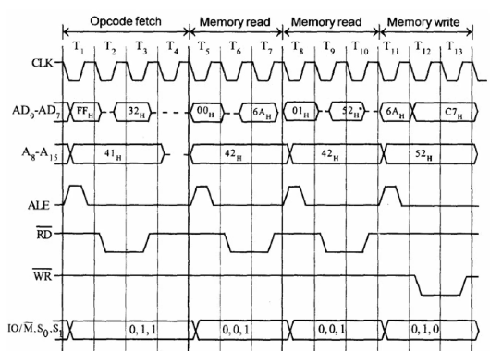
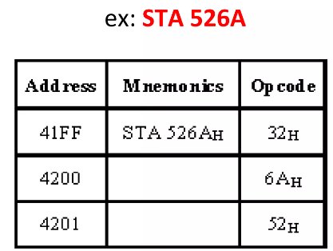
Timing Diagram of STA Instruction:
It requires 4 machine cycles and total of 13T states.
- Opcode Fetch (4T)
- Memory Read (3T)
- Memory Read (3T)
- Memory Write (3T)

Slide 29
Timing Diagram of LDA Instruction
The timing diagram of LDA instruction is same as of STA except the Memory Write Cycle, there is all Memory Read cycle.

Slide 30
Memory Interfacing
The Memory Interfacing in 8085 is used to access memory quite frequently to read instruction codes and data stored in memory. This read/write operations are monitored by control signals. The microprocessor activates these signals when it wants to read from and write into memory.
For Memory Interfacing in 8085, following important points are to be kept in mind.
Microprocessor 8085 can access 64Kbytes memory since address bus is 16-bit. But it is not always necessary to use full 64Kbytes address space. The total memory size depends upon the application.
Generally EPROM (or EPROMs) is used as a program memory and RAM (or RAMs) as a data memory. When both, EPROM and RAM are used, the total address space 64Kbytes is shared by them.
The capacity of program memory and data memory depends on the application.
It is not always necessary to select 1 EPROM and 1 RAM. We can have multiple EPROMs and multiple RAMs as per the requirement of application.

Slide 31
We can place EPROM/RAM anywhere in full 64 Kbytes address space. But program memory (EPROM) should be located from address 0000H since reset address of 8085 microprocessor is 0000H.
It is not always necessary to locate EPROM and RAM in consecutive memory For example : If the mapping of EPROM is from 0000H to OFFFH, it is not must to locate RAM from 1000H. We can locate it anywhere between 1000H and FFFFH. Where to locate memory component totally depends on the application.
The memory interfacing requires to :
- Select the chip
- Identify the register
- Enable the appropriate buffer.
Microprocessor system includes memory devices and I/O devices. It is important to note that microprocessor can communicate (read/write) with only one device at a time, since the data, address and control buses are common for all the devices. In order to communicate with memory or I/O devices, it is necessary to decode the address from the microprocessor. Due to this each device (memory or I/O) can be accessed independently. The following section describes common address decoding techniques.

Slide 32
Address Decoding Techniques :
- Absolute decoding/Full Decoding
- Linear decoding/Partial Decoding
Absolute decoding:
In absolute decoding technique, all the higher address lines are decoded to select the memory chip, and the memory chip is selected only for the specified logic levels on these high-order address lines; no other logic levels can select the chip. Fig. below shows the Memory Interfacing in 8085 with absolute decoding. This addressing technique is normally used in large memory systems.

Slide 33
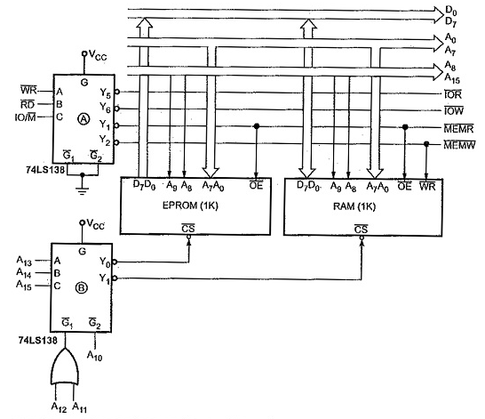

Slide 34
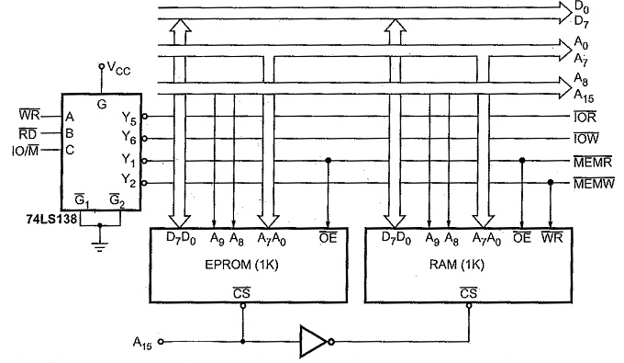
Linear Decoding
In small systems, hardware for the decoding logic can be eliminated by using individual high-order address lines to select memory chips. This is referred to as linear decoding. Fig. below shows the addressing of RAM with linear decoding technique. This technique is also called partial decoding. It reduces the cost of decoding circuit, but it has a drawback of multiple addresses (shadow addresses).

Slide 35
Different types of Memory Chips in 8085
Memory chips come in a variety of types and with different storage capacities. A broad classification of memory chips based on their read and write capability is:
RAM (Random Access Memory): We can read as well as write data on this type of memory. The chip of this type has pins for both memory read and memory write signals.
ROM (Read Only Memory): As the name suggests, we can only write data on this type of memory chip. The chip of this type has a pin only for memory read signal.
Data cannot be written on it by a microprocessor when it is connected in the circuit. But data can be written on it using some special techniques. This kind of memory is used to store programs, while RAM is used to store the data.
ROM is also of two types:
EPROM (Erasable Programmable Read-Only Memory): The contents of an EPROM are erased by UV rays. Data is written on it optically.
EEPROM (Electronically Erasable Programmable Read-Only Memory): As the name suggests, data is written and removed on this type of ROM electronically.

Slide 36
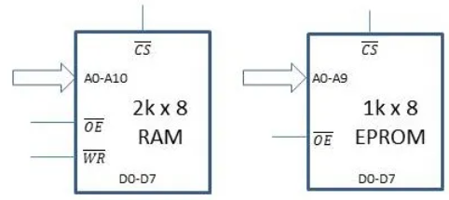
Memory interfacing – Problem statement
Interface a 1kB EPROM and a 2 kB RAM with microprocessor 8085. The address allotted to 1 kB EPROM should be 2000H to 22FFH. You can assign the address range of your choice to the 2 kB RAM.
The first step to solve this problem is to understand the pins of the given memory chips.
Pin diagram of memory chips
RAM and ROM both have same pins, except for WR pin, which is present in RAM and is not there in a ROM. Let us understand the pins one by one.

Slide 37
Data pins: Since each memory location stores eight bits, there are eight data lines D0-D7 connected to the memory chip.
Address pins: The number of address pins depends on the size of the memory. In this case, a memory of size 1 kB x 8 will have 2¹⁰ different memory locations. Hence, it will have ten address lines A0 to A9. Similarly, the 2 kB RAM will have 2¹¹ different memory locations. So, there are 11 address lines A0-A10.
CS pin: When this pin is enabled, the memory chip knows that the microprocessor is talking to it and responds to it accordingly. We need to generate this signal for each of the chips according to the range of addresses assigned to them. Basically, we select a chip only when it is needed. The Chip Select (CS) pin is used for this.
OE pin: When this active-low output enable pin is enabled, the memory chip can output the data into the data bus.
WR pin: Upon activation of this active-low memory write pin, data on the data bus is written on the memory chip at the location specified by the address bus.
VCC and GND pins: These pins serve the purpose of powering the ICs. For simplicity, we will not show these pins in the diagram.
There are three types of buses in 8085 – Address bus, data bus, and control bus. Each of these buses will be connected to the memory chip.

Slide 38
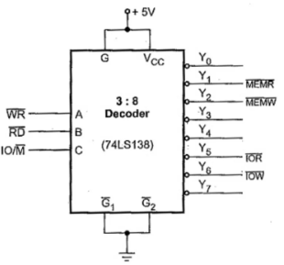
Connecting Control Signals
In the memory chips, there are two pins for control signals – OE (Output Enable) and WR (Memory Write). These will be connected to the control signals generated using a 3 to 8 decoder. To read about the generation of control signals, you can read our post on Demultiplexing of Bus and Generating Control Signals. The circuit for generating control signals is shown below.

Slide 39
Four control signals are generated when we input the WR, RD and IO/M signals from the 8085 to the 3:8 decoder – IOR, IOW, MEMR and MEMW. Since we are dealing with memory, we will just need MEMR and MEMW signals.
While reading from a memory chip, it’s output should be enabled. So, MEMR will be connected to the OE pin. Similarly, for writing to a memory chip, MEMW will be connected to the WR pin of the RAM. After completing these two connections, we are done with the control signals except CS. We will deal with that in a bit.
Data Bus interfacing
There are eight lines comprising the data bus of both 8085 and the memory chips. The interfacing of the data bus is the simplest part. We just connect corresponding lines (D0-D7 from 8085) to the corresponding pins (D0-D7 of the memory chip).
Address bus Interfacing
We have a 2kB RAM with 11 address lines. So, the first 11 lines of the address bus of 8085 will be connected to the corresponding address lines of the 2kB RAM. Similarly, the first 10 lines of the address bus of 8085 will be connected to the corresponding lines of 1kB EPROM. The remaining address lines will be used to generate the chip select (CS) signal.

Slide 40
Generating the chip select signal
This is a little tricky, but it’s the most important part of solving the problem. Let us proceed step by step and build up an intuition of how to generate the chip select signal for a memory of given size and given address range.
Let us tabulate the starting and ending address of the 1kB EPROM.
A15 is most significant, and A0 is the least significant bit. The address range for placing the EPROM is from 2000H to 22FFH (as given in the question.) Translating these to binary:
2000H = 0011 0000 0000 0000
22FFH = 0011 0011 1111 1111

Slide 41
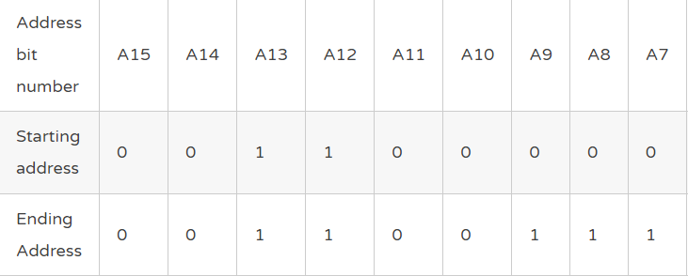
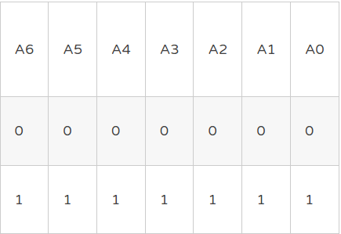

Slide 42
From the above table, we can observe that ten bits from A0 to A9 are changing. These ten bits are directly connected to the address lines of the memory chip.
These ten bits take the value of either 0 or 1 to form addresses. The first address is 00 0000 0000, and the second address is 00 0000 0001, the third is 00 0000 0010 and so on. The last address will be 11 1111 1111.
Meanwhile, bits A10 to A15 do not change and don’t have any effect on the addressing process inside the memory chip. So, we can conclude that the values of bits A15-A10 (0011 00) given in the above table are in a unique, unchanging configuration for this memory chip.
If even one of these bits changes, the address won’t belong to this memory chip. So, we can use these values of A15-A10 to uniquely identify this memory chip, which is exactly what the CS signal is supposed to do.

Slide 43
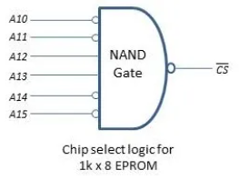
We can say that when A15 = A14 = A11 = A10 = 0 and A13 = A12 = 1, then our memory chip should be selected. Now, we need to design the logic to generate the CS signal. The resulting Boolean equation of CS will be:
CS = Complement of (A15* . A14* . A13 . A12 . A11* . A10*)
This equation can be implemented using NAND Gate. The final chip select logic for 1kB EPROM is illustrated below.
Now, we have to generate a chip select signal for the second memory chip, which is 2kB RAM. The process is quite similar and differs from the previous one in two ways:
- The size of the memory is different. So, there are 11 address lines instead of 10.
- We are not given an address range here. We are given the liberty to decide on our own.

Slide 44
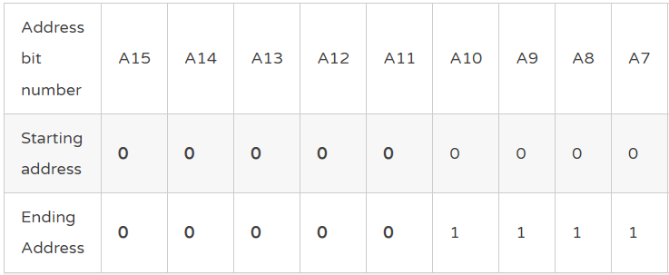
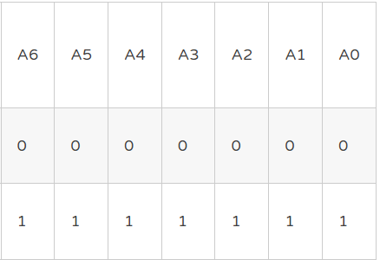
Similar to the previous case, we connect the first 11 address lines of the 8085 microprocessor to the 11 address lines of the 2kB RAM. These bits will take values of 0 and 1 and will generate 2 * 1024 different addresses. The address bits A10-A0 will vary from 000 0000 0000 to 111 1111 1111.
What about the remaining address bits? Well, they don’t have any role in the addressing of the memory in this 2kB RAM. So, we can fix them to a certain value without affecting anything. Let’s fix them to 0000 0. Thus, the address range for this chip becomes 0000 0000 0000 0000 to 0000 0111 1111 1111. In hexadecimal, the address range will be from 0000H to 07FFH.

Slide 45
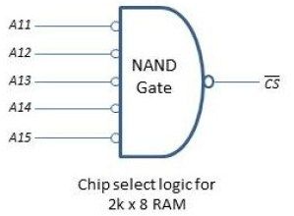
We use a similar technique here. We use the remaining bits A15-A11 to uniquely identify this chip i.e., to generate chip select signal. So, the boolean equation will be
CS = Complement of (A15* . A14* . A13* . A12* . A11*)
The implementation of this equation using NAND Gate to generate the CS signal is shown in the following image.

Slide 46
The final circuit
Since we now have the chip select logic and have decided all the connections, it’s time to finalize the circuit. The entire external memory interfacing circuit can be broken up into five different parts:
- 8085 microprocessor
- Demultiplexing of address/data bus
- Generation of control signals
- Generation of chip select signals
- Memory chips
The images below show the final circuit with all the five parts listed above integrated into a single circuit. Just the connections are shown in the first diagram. In the diagram following it, different subsections of the circuit are labeled.

Slide 47
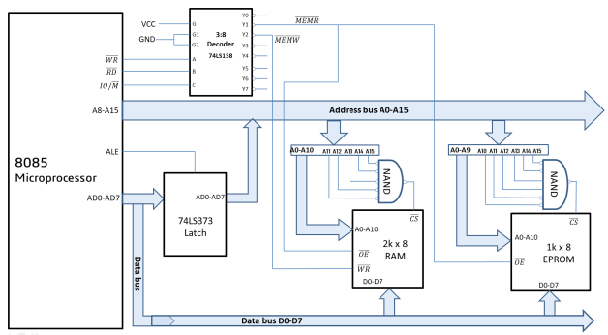

Slide 48
